Slide 1
Health related issues in the coronavirus pandemic
Notes:
Problems relating to connecting to health care are ;
Limited physical access to surgery's and practices (harder to be seen by a doctor) because people don’t want to spread the virus.
Can be Language Barriers .- can impede effective healthcare support
Time limitations – appointments only able to be booked with work hours and appointments can only take places in regular work hours.
Patient registration for bookings systems is limited to only within surgery times / doctor practices require you to fill out a hardcopy form for registering with a gp rather then online.

Slide 2
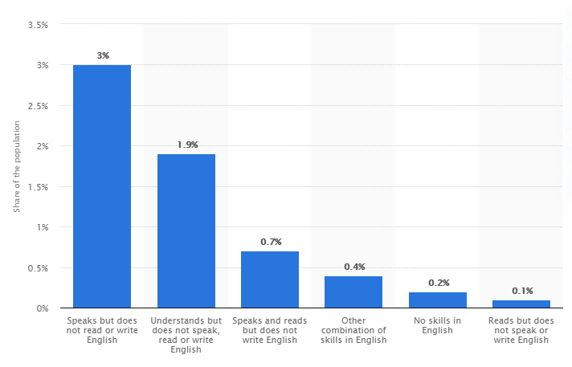
Language Barriers
Proportion of population of Scotland with some weaknesses in English in 2011.
Notes:
Going to talk about possible language barriers
https://www.statista.com/statistics/329860/share-scotland-population-english-language-issues/

Slide 3
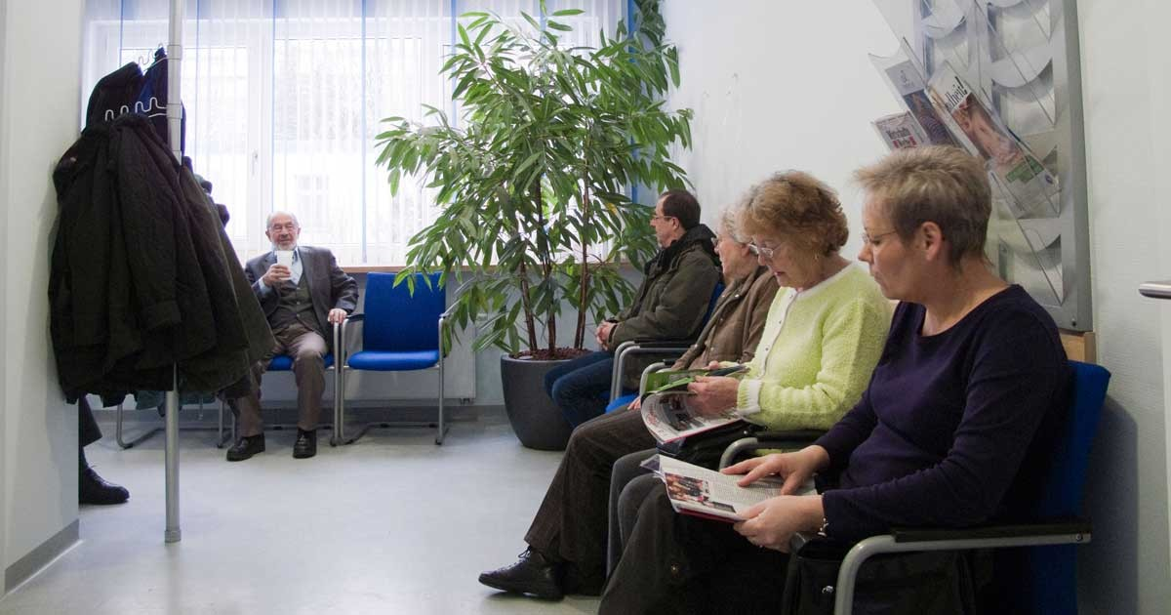
Limited physical access to surgery's and practices

Slide 4
Our Product
What it does:
A web based app that allows users to connect ,book and register to your closest general practice, as well as providing general health information.

Slide 5
Features
Provides general health care advice.
Facilities booking of appointments with health cares GP’s, allows you to transfer information to a new GP, without need to fill out forms.
Provides contract information of all hospitals, GPS’s and health locations near users on app map.

Slide 6
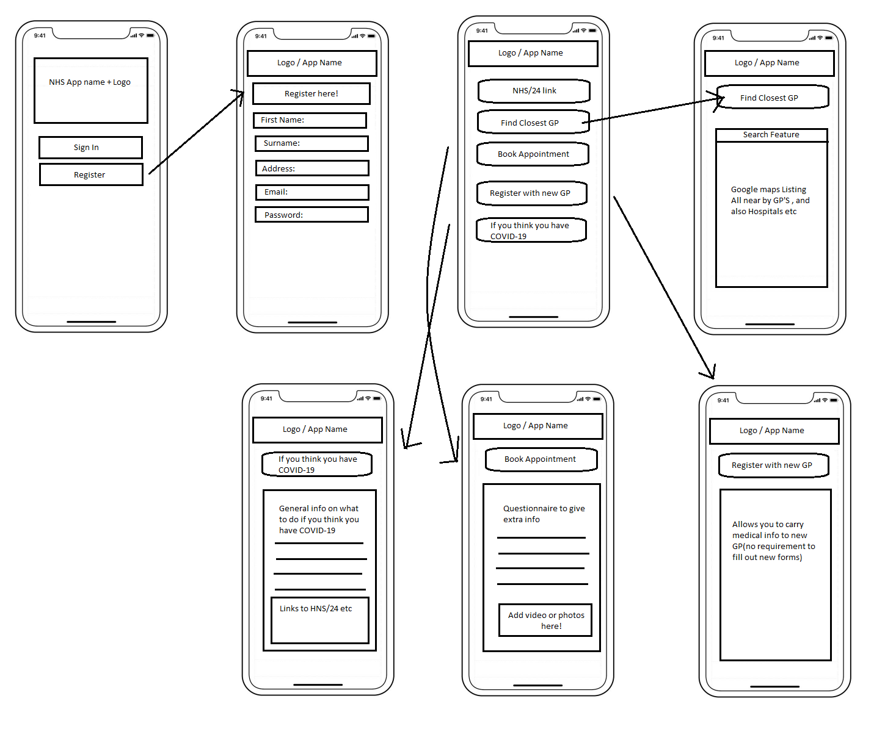
App Wireframes

